Slide 1
ENSE 400 Bi-Weekly Scrum Report-Out
Westside Boys
Daris Lychuk & Kegan Lavoy
November 1st, 2019

Slide 2

Project deats
What problem(s) are you trying to solve?
Make finding the best insurance & medication easy and fast for people without benefits
What gap are you filling?
Comparison between multiple insurance providers
What innovation are you creating?
Web application that auto compares insurance providers based on user input

Slide 3

Project & documentation review
What are you currently working on?
Personas
Contingency plan (kind of)
Reviewing information sent by URSU
Functional Requirements Doc
Notes:
Start collecting more insurance information ourselves from different companies (use our parents/persona as target customers)
Start UI/UX initial design?

Slide 4
Project & documentation review
“Show me what you got”
Project Vision: Make finding the best insurance smooth and easy for all types of people
Rationale: Currently quite difficult to even get a quote, even more so to compare between providers
Stakeholders: Insurance providers (emailed URSU, got info), people without coverage, government (if their plan is one we use)
Constraints: Insurance companies may have private price calculations, may not want to join at all
Completed intro, purpose, scope, background, assumptions & constraints and methodology sections of FRD.
Notes:
Start collecting more insurance information ourselves from different companies (use our parents/persona as target customers)
Start UI/UX initial design?

Slide 5
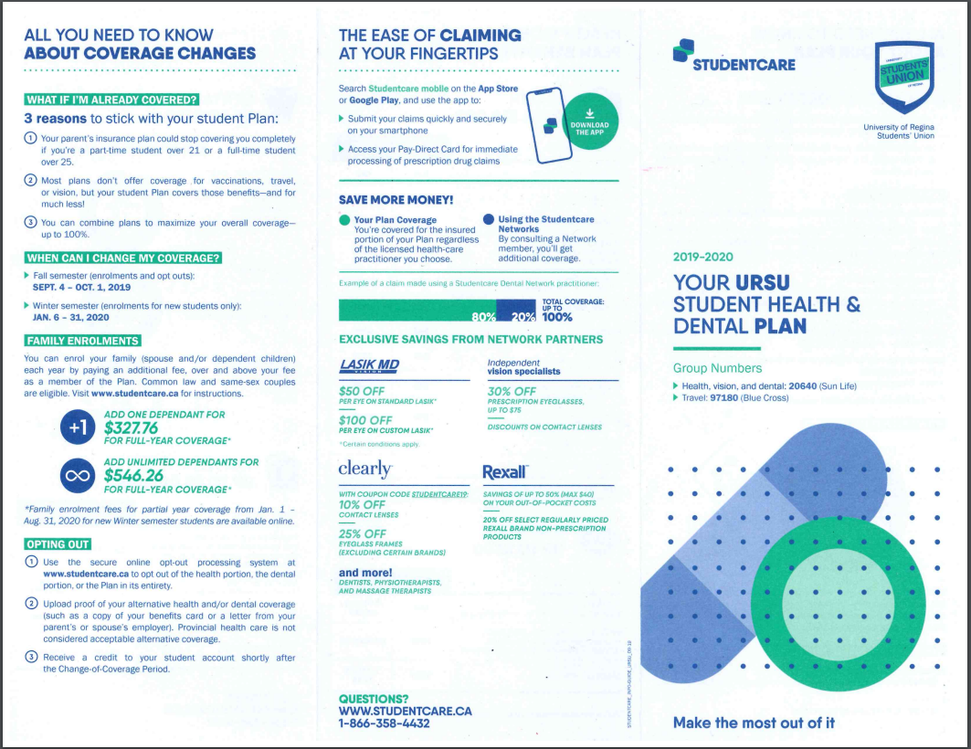

Slide 6
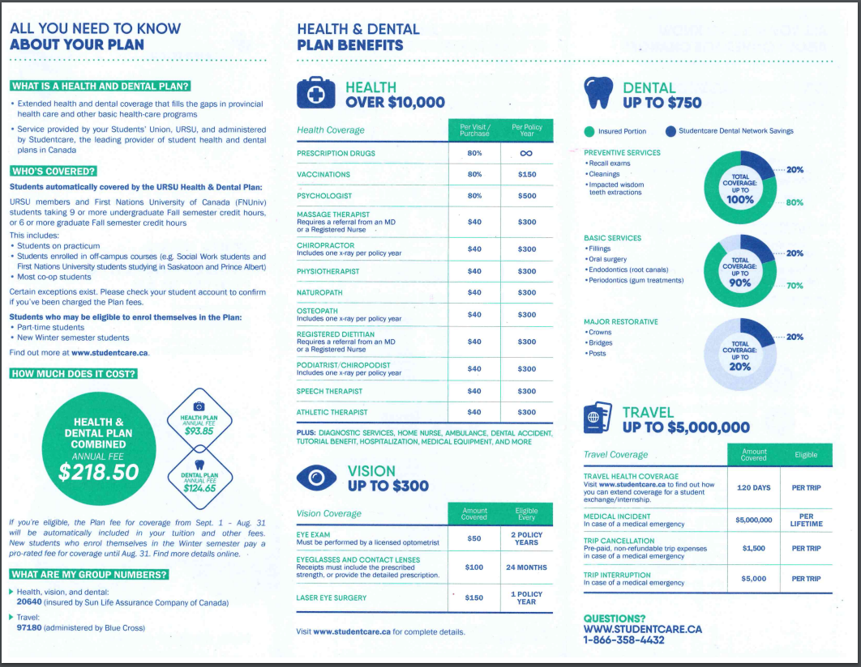

Slide 7
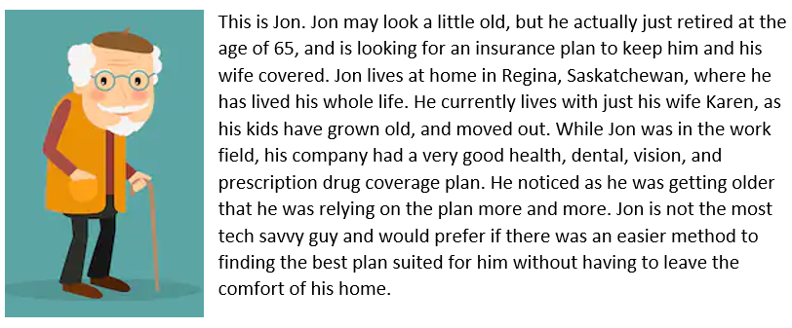
Project demo - Persona #1
Notes:
https://landofooo.storiesonboard.com/m/westside-boys

Slide 8
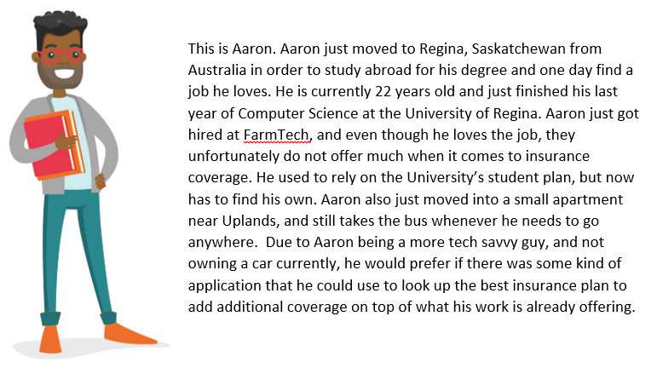
Project demo - Persona #2
Notes:
Persona for u of r student
Be transparent when contacting other companies

Slide 9

Group reflection
Do you feel you are on track?
We feel like we are. We have some data from URSU, we just have to look/examine it now.
We have been really busy with midterms recently, but feel as though we will get more done in the coming future.
Do you feel there are barriers to your success (if any)?
Getting more insurance companies on board
Importing their data if they do come on board
Getting approximate estimates on pricing from other companies.
Midterms (sooo many recently #6classessuck)
Notes:
Focus of a key customer
How we are getting the data
Pick a persona of a customer
Start requirements doc

Slide 10
Group reflection
Do you need any help going forward?
Other than more target customer, or suggestions for target customers, not really
Any other questions or concerns?
Contingency plan still needed??
Improve our personas?

Slide 11
Image refs
Show me what you got, https://pictures.abebooks.com/isbn/9781548899530-us-300.jpg
Patrick, https://imgflip.com/memetemplate/43274976/spongebob-patrick-nail-saw
College, https://cdn1.vectorstock.com/i/1000x1000/60/85/african-american-college-student-holding-books-vector-20596085.jpg
Old man, https://image.shutterstock.com/image-vector/old-man-glasses-walkins-cane-260nw-351017879.jpg

